Slide 1

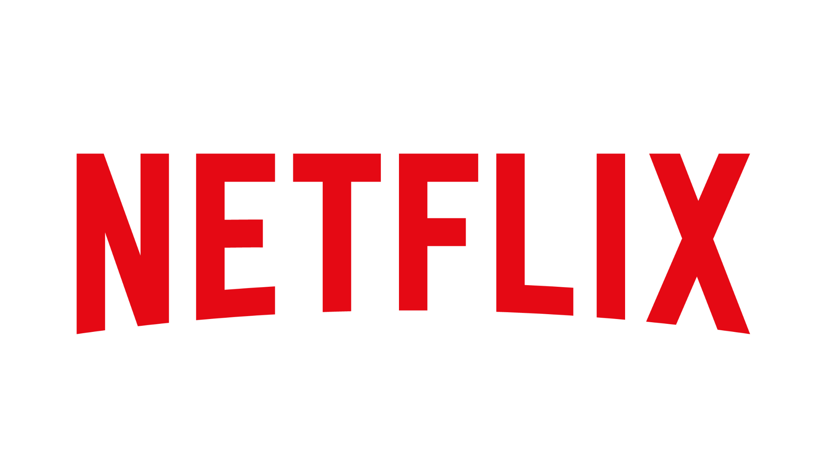
Netflix: market dominance in the streaming services industry
Notes:
Attributes for Platform-Attribute Lift Analysis:
Original
Content
Price
Connection
Quality
Interface
Ads
Platforms:
netflix
hulu
YouTube
disney
paramount
hbomax
sling
amazon
apple

Slide 2






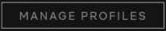
Who’s Presenting?
Oluwaseun Ibitoye
Ohyoon Kwon
Ambikha Maharaj
Ankita Kundra
Samuel Oh
Aditya Soni

Slide 3




Agenda
Problem
Statement
Data
Analysis
Insights/
Advice

Slide 4

Problem
Statement
Is Netflix still dominant in the streaming services industry?

Slide 5
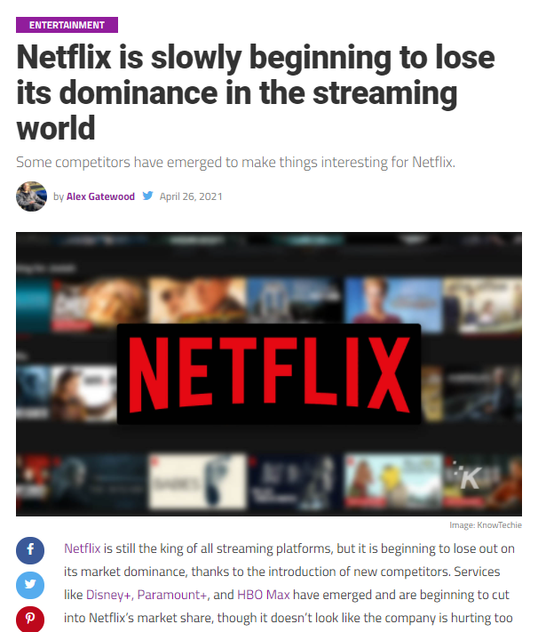
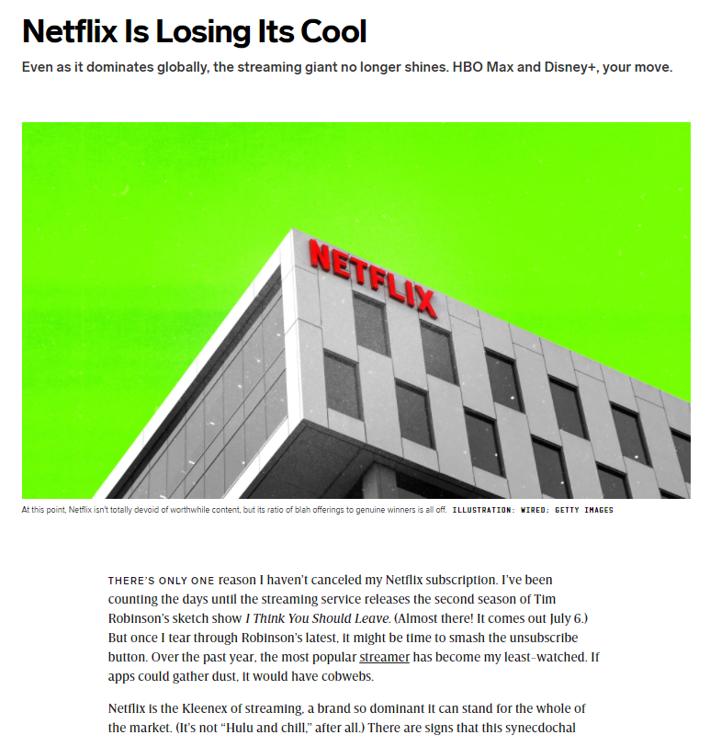
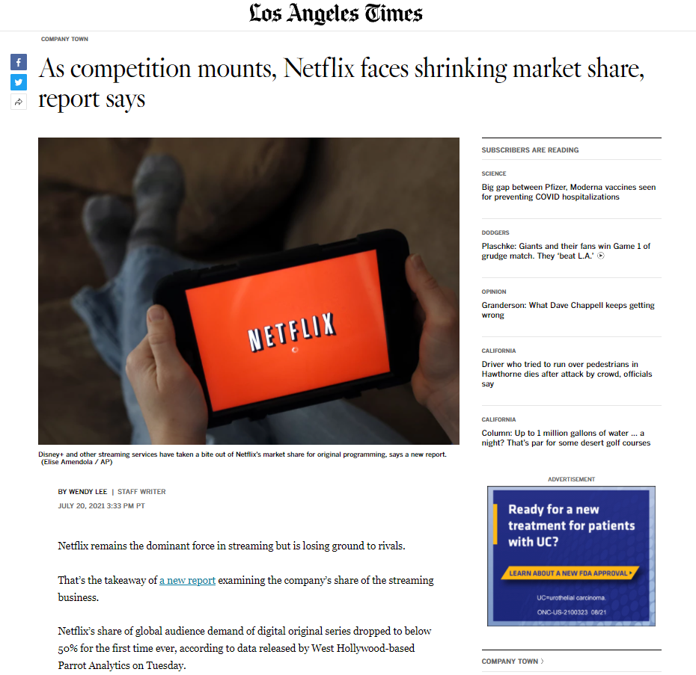
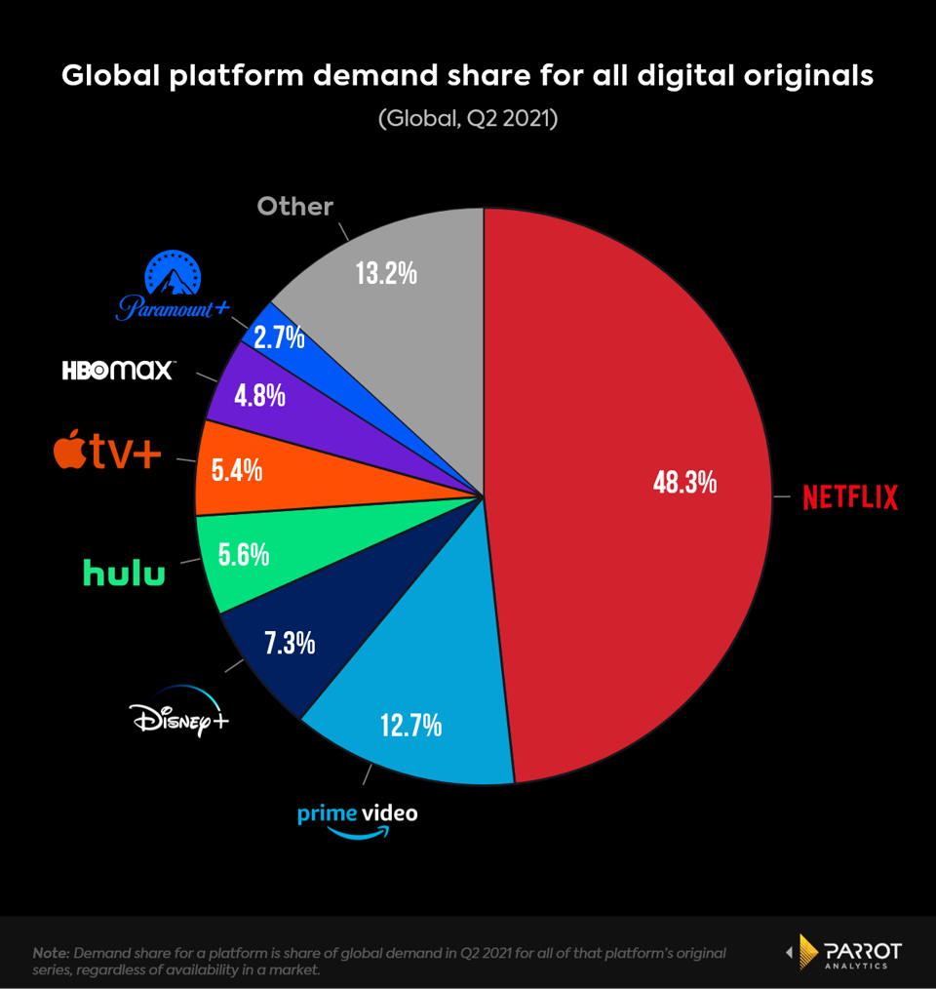
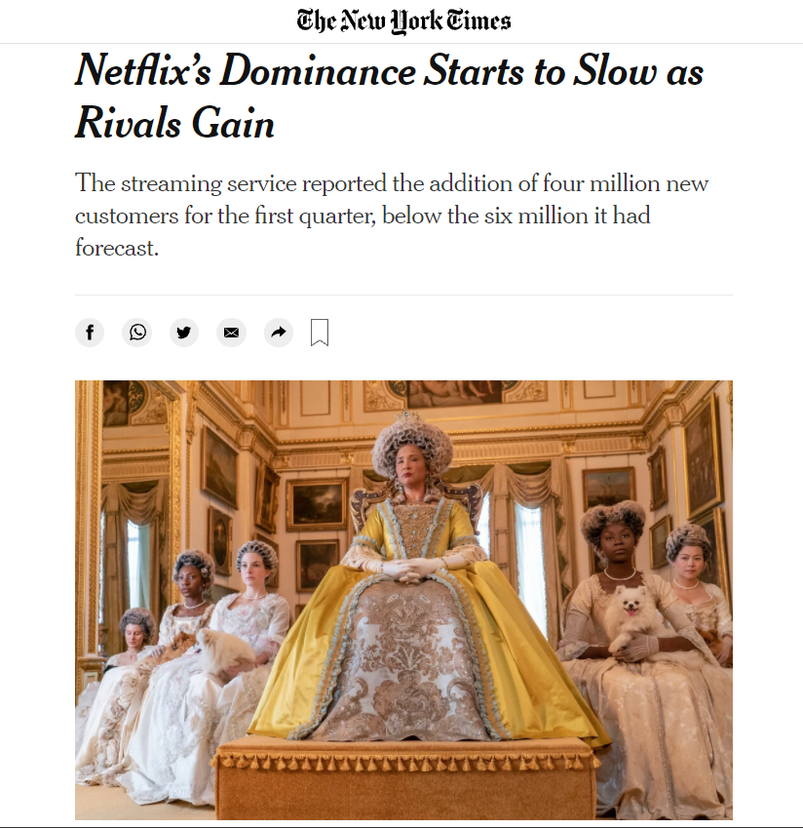
Why does it matter?
Notes:
Why does it matter?
Netflix is one of the oldest streaming companies as it was started in 2007 and the advantages they had before which contributed to their rise may be not be as advantageous now as other companies such as hulu, hbomax, paramount and other streaming platforms are on the rise as well
This overcoming of dominance of other streaming services may eventually impact Netflix itself and also its subscribers as well and since they may want to improve their streaming in order to stay on trend with their competitors
This problem can also impact competitors and can affect their subscribers as well and competitors can learn from Netflix’s techniques on how to be more attractive to subscribers by improving their own content and giving them more of an edge
What made us do this and why it matters for us

Slide 6
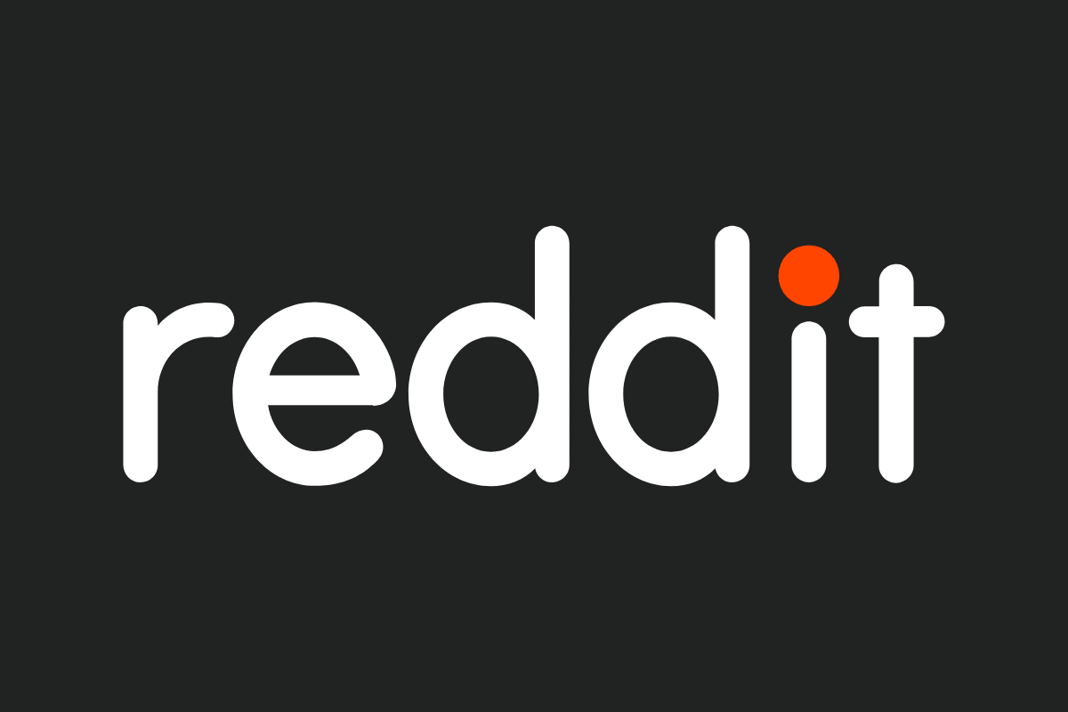
Data
reddit - /r/CordCutters
Over 185,000 comments (2020-2021)
Data Cleaning (stopwords, punctuations, etc.)
Replaced platform names (e.g., disney)
Retained 36,500 comments
Replaced attributes (e.g., cost → price)
Word | Frequency
Youtube | 12,010
Amazon | 11,215
Hulu | 9,538
Netflix | 9,284
HBO Max | 7,948
Apple | 7,865
Disney | 6,057
Sling | 4,998
Paramount | 1,378
Notes:
Scraping and Cleaning
How else we were able to clean/scrape
180,000 comments from 2020-2021
Sentiment analysis -remove stop words
Some comments that compare multiple service together only sentiment on each of the services
Comments ^ we will analyze sentiment analysis for that word and proceeding 2 words and take the sentiment of that sentence - comment has more than 2 platform and pro
And index -2 and index +2 and do sentiment analysis for that comment

Slide 7
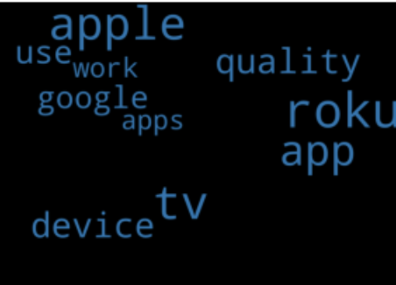
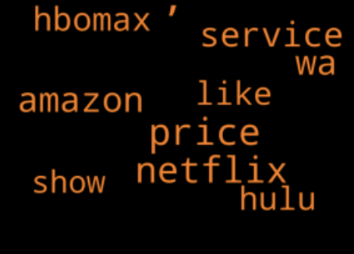
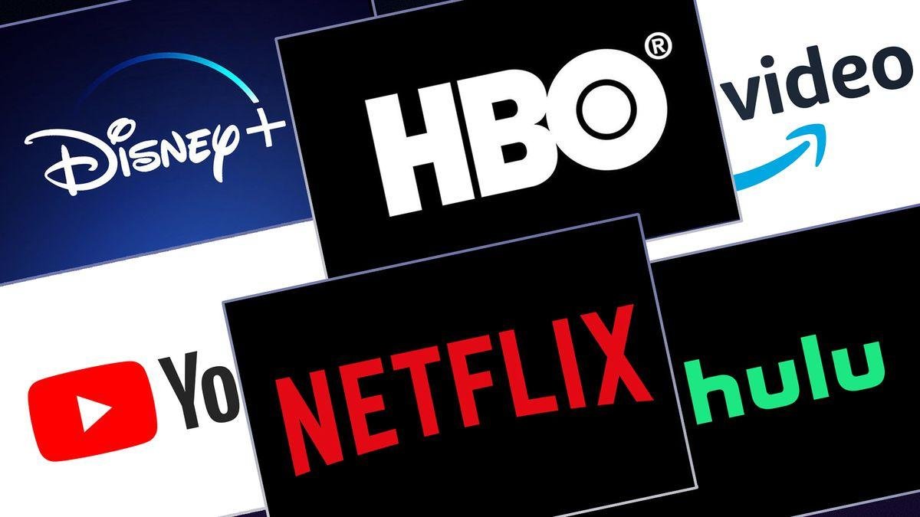
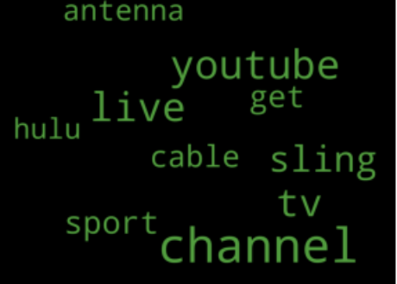
Topic Modeling
Notes:
Topic modelling for Cord Cutters subreddit using LDA
3 main topics
Green: talking about traditional cable/tv experience (cable, antenna, tv)
Orange: streaming services & their pricing (hbomax, netflix, amazon, price)
Blue: talking about services that offer hardware devices for streaming and their quality (apple tv & roku)

Slide 8
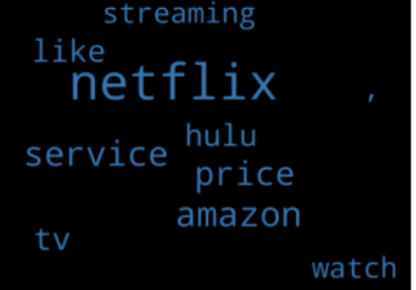
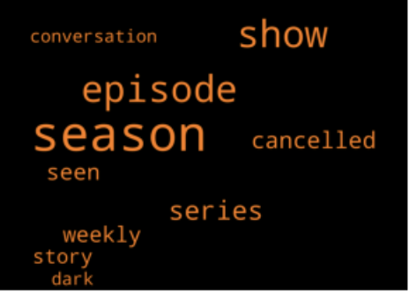

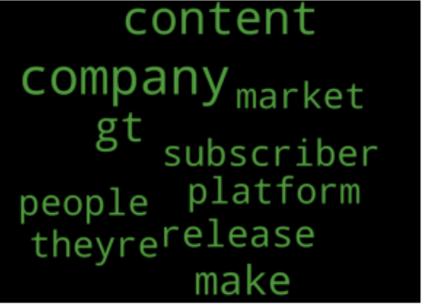
Topic Modeling
Notes:
Topic modelling for only comments containing Netflix
3 main topics
Green: talking about the company as a whole so about the platform, market
Orange: talking about their content, cancelled shows (shows, episodes)
Blue: talking about netflix in relation to other streaming services and their attributes (netflix, hulu, amazon)

Slide 9
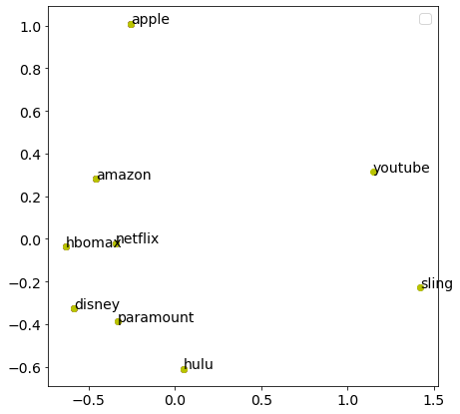
Mds plot: Similarity between platforms
Potential Competitors
Notes:
POTENTIAL COMPETITORS - amazon, hbomax
Close cluster - disney, hulu
Potential switching behaviours between clusters

Slide 10
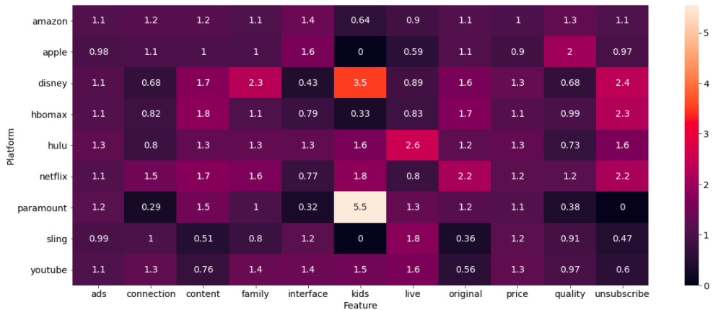
Association: platforms vs attributes
Sentiment Analysis
Notes:
All positive sentiments

Slide 11
Sentiment analysis on individual platforms
Platform | Score
Amazon | 0.41
Peacock | 0.36
Apple | 0.34
Sling | 0.32
Netflix | 0.29
Hulu | 0.28
Paramount | 0.26
Hbomax | 0.25
Disney | 0.24
Platform | Negative | Positive
Disney | 35.14% | 58.81%
Netflix | 20.22% | 64.04%
Hbomax | 19.28% | 59.05%
Peacock | 18.18% | 72.72%
Hulu | 18.10% | 61.99%
Paramount | 16.84% | 57.80%
Apple | 15.48% | 66.47%
Amazon | 15.08% | 79.81%
Sling | 14.74% | 64.48%
Notes:
Left: Sentiment scores for all the platforms are positive from 0.24 to 0.41, so we concluded that there are no significant insights that we can draw from the table.
So we decided to dive deeper into this analysis by, instead of looking at the magnitude of the sentiments, to look at the proportion of negative and positive comments out of the comments that mention only each platform. We discovered that Netflix came second place for the proportion of negative comments.

Slide 12
Sentiment analysis on attributes
Top 3 negative comments for each attribute
Proportion of negative comments for each platform
FAMILY | Sentiment_Score | Positive Comments | Negative Comments
HBO Max | 0.44 | 71.43% | 28.57%
Netflix | 0.38 | 74.07% | 18.51%
Amazon | 0.47 | 80% | 17.50%
‘Dark’ was mentioned in topic modeling
Disney & Hulu are more family-friendly
ORIGINAL | Sentiment_Score | Positive Comments | Negative Comments
DISNEY | 0.35 | 71.43% | 23.81%
NETFLIX | 0.45 | 80.47% | 16.74%
HBO MAX | 0.50 | 88.61% | 8.86%
Greatest number of original contents
More than all the others’ combined!
Potential competitors?
Notes:
We also conducted sentiment analysis of the attributes for each platform and almost all the sentiments were positive.
Out of all the attributes, the proportion of negative comments of Netflix are relatively high for the ‘Family’ and ‘Original’ attributes. Each of these tables show the top 3 platforms with higher negative comments.
Family
In the earlier Topic modeling slides, we found that ‘dark’ was included in the ‘content’ topic. From the table, we can see that there are relatively more negative comments about the family attribute. On the other hand, Disney and Hulu are known to be more family-friendly, which we assumed was why they were not included in the top 3. So this shows how there is a chance of Netflix losing certain subscribers to those family-friendlier platforms.
Original
From the table on the right, we can see that netflix ranks 2nd place for the highest proportion of negative comments about original contents. So we looked into the originals of each of the platforms and found out that netflix actually had the greatest number of original contents. The number of more than all the others’ combined. So we wanted to what aspect of the Netflix’s originals showed areas of improvement and this led to our further investigation about the original content of the platforms.
Lastly, how HBO Max and Amazon are commented about the same attributes in a similar way may underline that they are potential competitors.

Slide 13
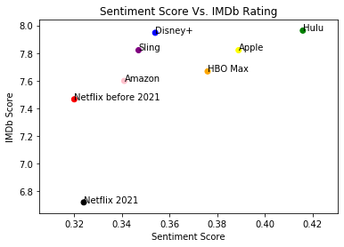
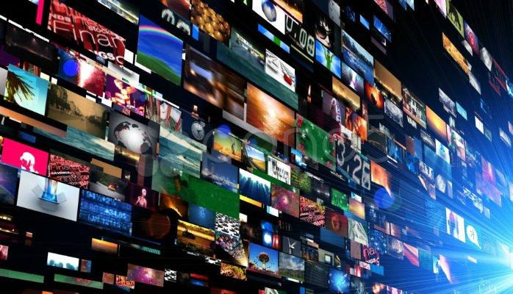
Sentiment analysis original contents
Notes:
The original content is one of the most important features in the TV streaming market. Based on the previous analysis, we decided to compare sentiment scores with IMDb rating of the entire original contents of each platform. The overall trend of this relationship seems to be proportional. We could see that Netfilx’s relatively low scores for both IMDB and sentiment. One issue we thought of is that Netflix might be focusing less on the quality of the contents, compared to the quantity of the contents, which is about 4 times more than the sum of all other streaming services’. 1918 vs 523

Slide 14
conclusion
ConClusion
Still the dominant platform, but competition is fast catching-up
recommendations
Biggest competitors: HBOMAX, Amazon, and Disney
Focus on quality over quantity in their original content
Further differentiate strengths compared to competitors
Future scope
Develop platform recommendation system for customers
Notes:
any other relevant information regarding netflix dominance, concluding statements
Netflix is still one of the most popular platforms , should not rely on their first mover advantage
Focus on quality over quantity in their original content
The attributes are average compared to the competitors. So improving in any of these will be good (live, connection, etc.)
Biggest competitors: HBOMAX and Amazon
Develop Recommendation System for Platforms → beneficial for people!!!!!

Slide 15
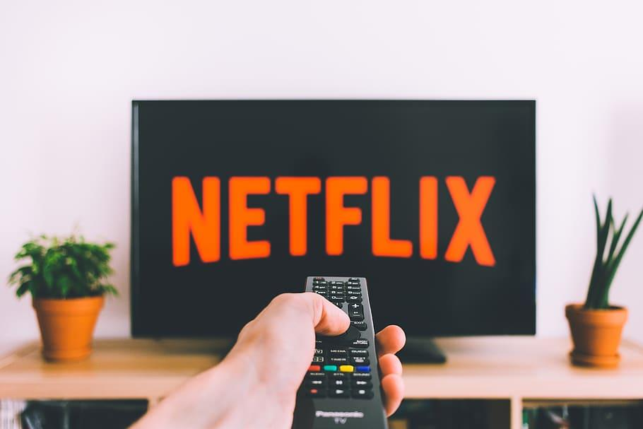
THANK YOU!
Notes:
Attributes for Platform-Attribute Lift Analysis:
Original
Content
Price
Connection
Quality
Interface
Ads
Platforms:
netflix
hulu
YouTube
disney
paramount
hbomax
sling
amazon
apple

